Slide 1


LANCASTER ORTHOPEDIC HISTORY

Slide 2
INTRODUCTION
Dr. Gerald Rothacker
Orthopedic – Orthopaedic
Straight - Child
“The Medical Specialty that includes the Preservation, Investigation, and Restoration of the Form and Function of the Extremities, Spine and Associated Structures by Medical, Surgical and Physical Methods.”

Slide 3
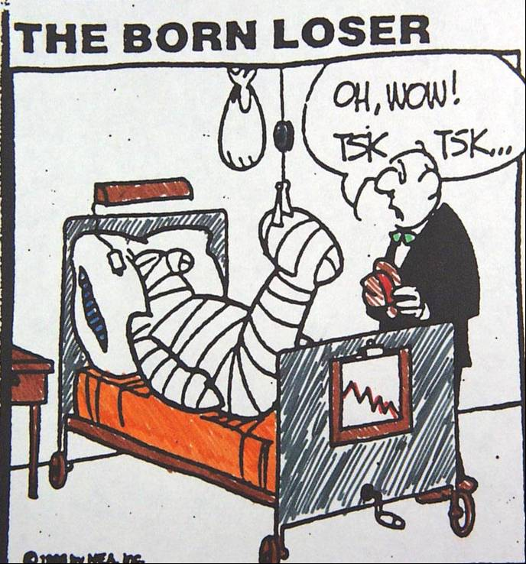
ORTHOPEDIC SURGEONS
WE FIX YOUR
BONES
JOINTS
TENDONS
MUSCLES

Slide 4
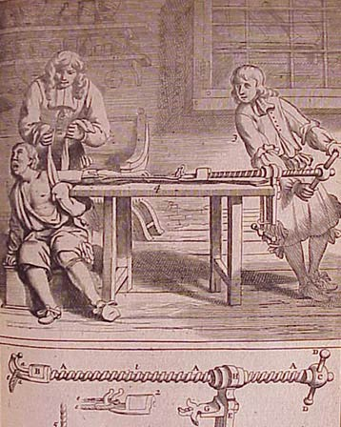
PRE – 19th CENTURY
PHYSICIANS
  FRACTURE REDUCTIONS
  BRACE
  DRAIN ABSCESS
  TRACTION
SURGEONS
  AMPUTATION

Slide 5
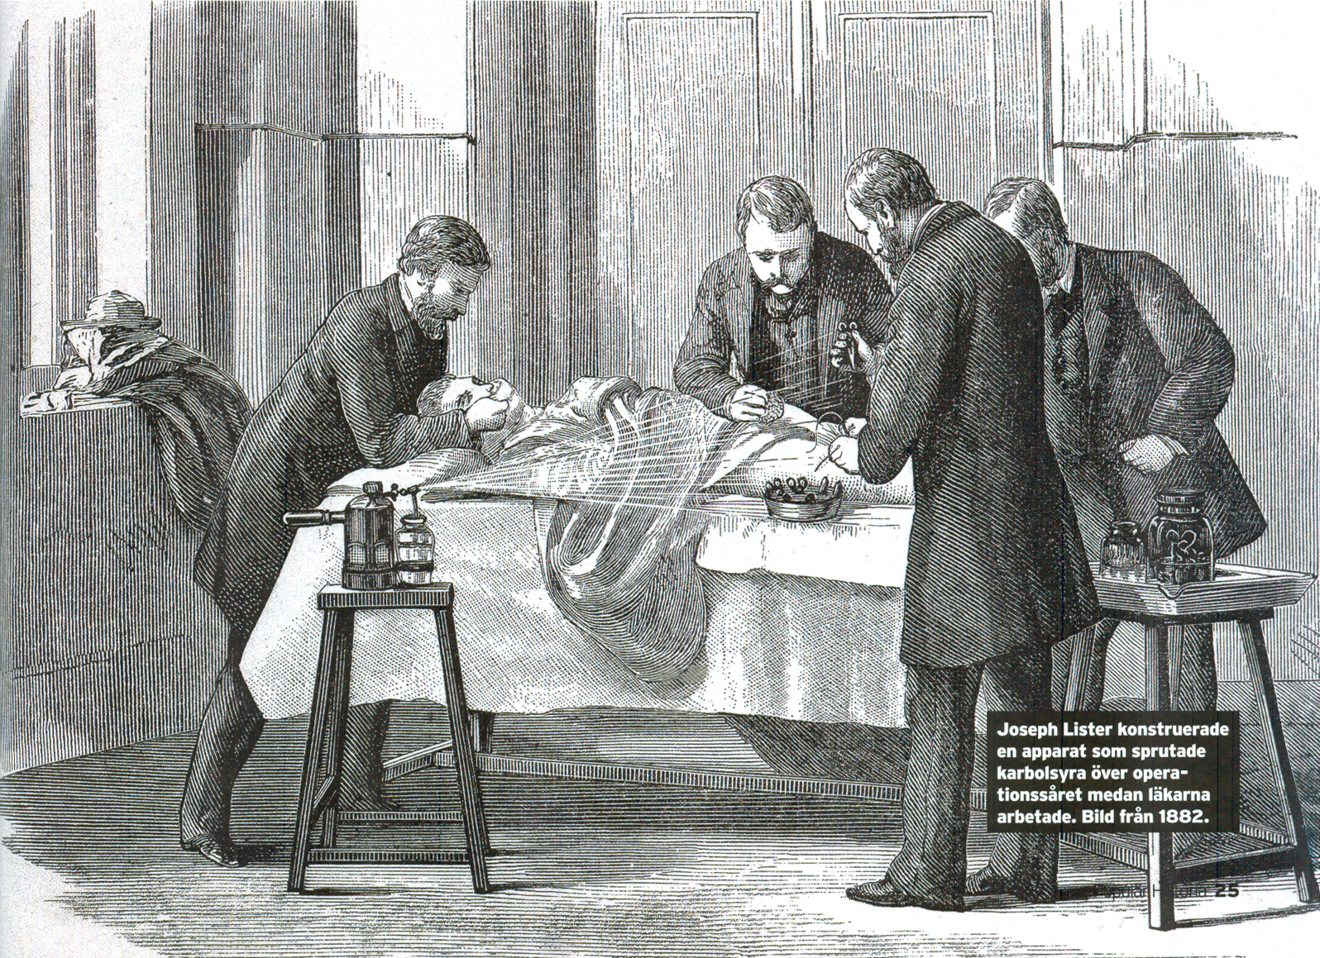
2ND HALF 19th CENTURY
1847 – ANESTHESIA
  GERM THEORY OF INFECTION
  Semmelweiss
  Pasteur
  Koch
ANTISEPSIS
  Lister
PLASTER CAST
1895 – X-RAY
  Roentgen

Slide 6
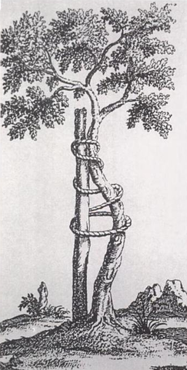
INTO THE 20th CENTURY
AMERICAN ORTHOPAEDIC ASSOCIATION – 1887
DEPARTMENT OF ORTHOPEDIC SURGERY
  U OF P – 1889
  JEFFERSON – 1897
  MAYO CLINIC – 1910
SHRINER’S HOSPITAL, PHILADELPHIA - 1926

Slide 7
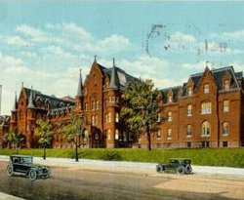
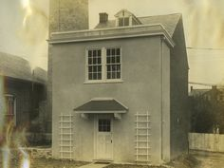
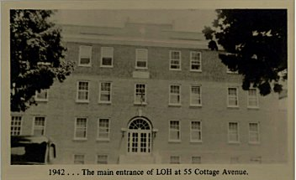
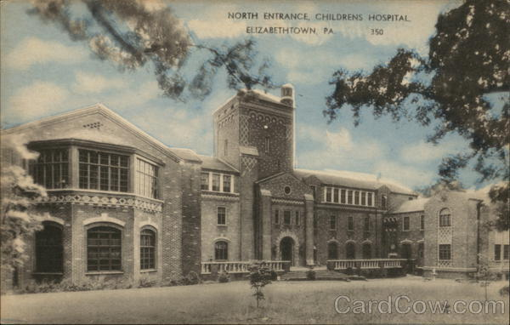
TWENTIETH CENTURY
LANCASTER COUNTY
ST. JOSEPH HOSPITAL- 1883
LANCASTER GENERAL HOSPITAL – 1893
LANCASTER OSTEOPATHIC HOSPITAL – 1921
STATE HOSPITAL for CRIPPLED CHILDREN – 1925, ELIZABETHTOWN

Slide 8
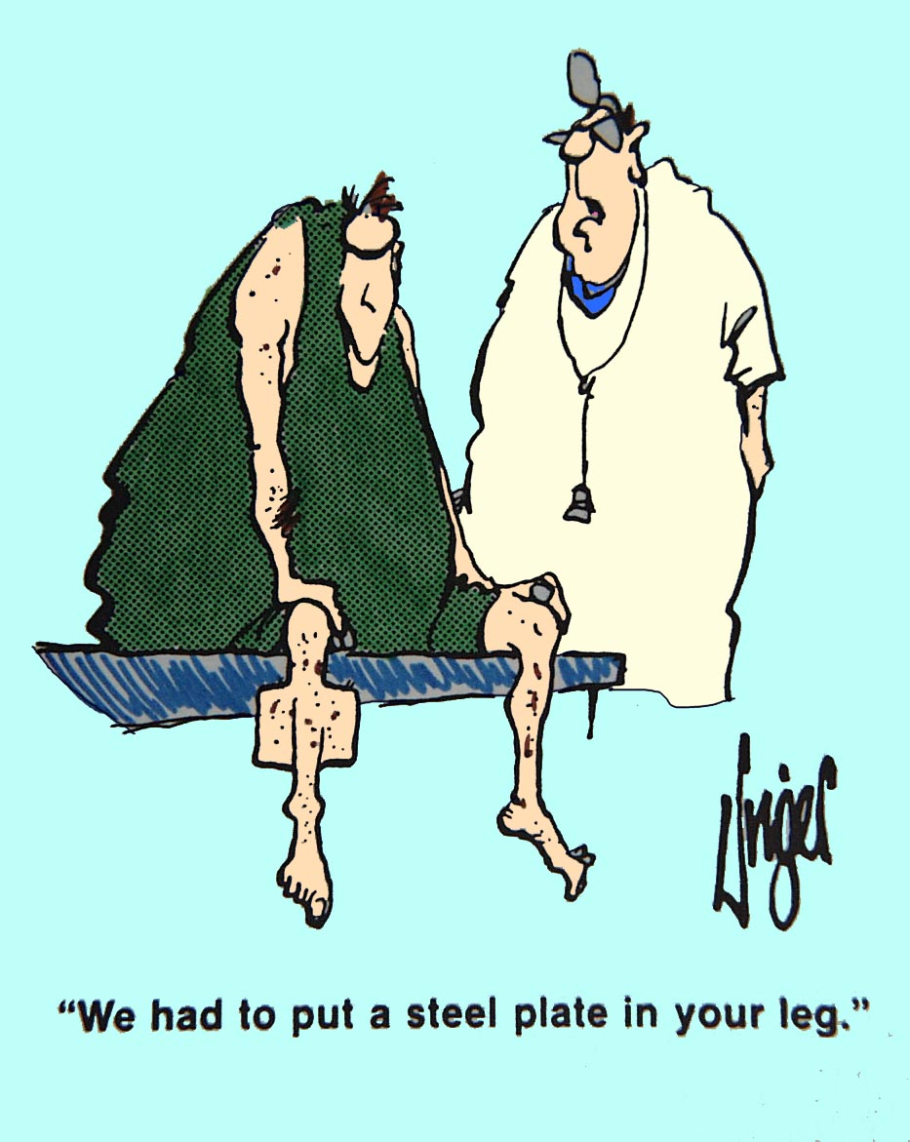
TWENTIETH CENTURY LANCASTER COUNTY ORTHOPEDICS
PRIOR TO 1950s
TRAUMA SURGERY BY GENERAL SURGEONS
  DRS ATLEE
  DRS FARMER
  DRS PONTIUS
  DR DAVIDSON

Slide 9
TWENTIETH CENTURY LANCASTER COUNTY ORTHOPEDICS
1927 – Dr. J T Rugh , Came up from Philadelphia
1933 – Dr. Chambers, Staff LGH 1933-37
1940’s – Dr. P. David Nutter, Dr. Charles Brimfield (York), Dr. Eaton (Philadelphia)
1950s – Dr. Marvin Goodman,Dr. Sidney Runyan, Dr. Ed Lancaster, Dr. George Kent**
1960s – Dr. Bill Phippen, Dr.Charles Winter, Dr. Howard Robbins
1970s- Dr. Al Cooke, Dr. John Shertzer, Dr. Ed Maley, Dr. Bob Matthews, Dr. Doug Kells, Dr. Joe Seventko, Dr. Dave Hughes, Dr. Jim O’Neil

Slide 10
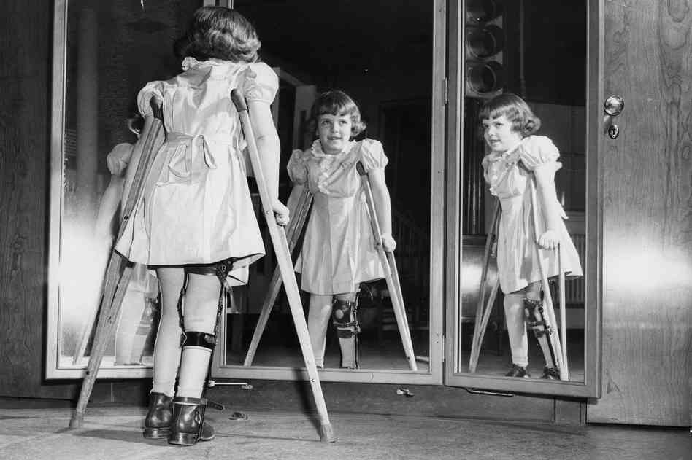
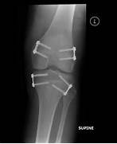
ELIZABETHTOWN CRIPPLED CHILDREN’S HOSPITAL
POLIO WEAKNESS
  BRACE
    THOUSANDS
  JOINT FUSION
  TENDON TRANSFER
POLIO LEG LENGTH INEQUALITY
  EPIPHYSEODESIS
    STOP THE GROWTH

Slide 11
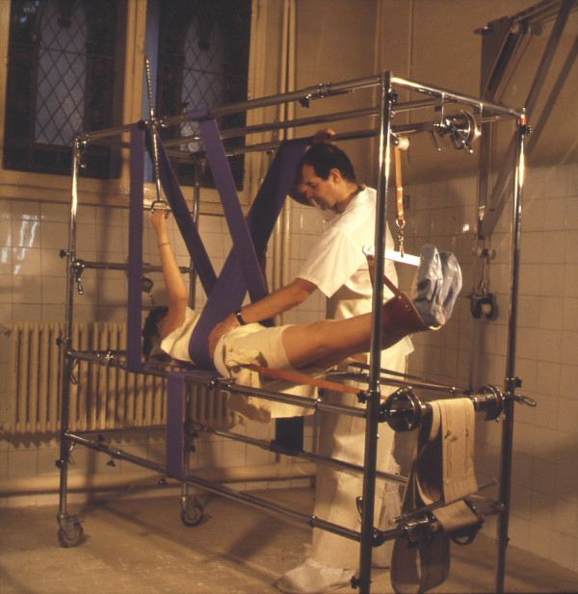
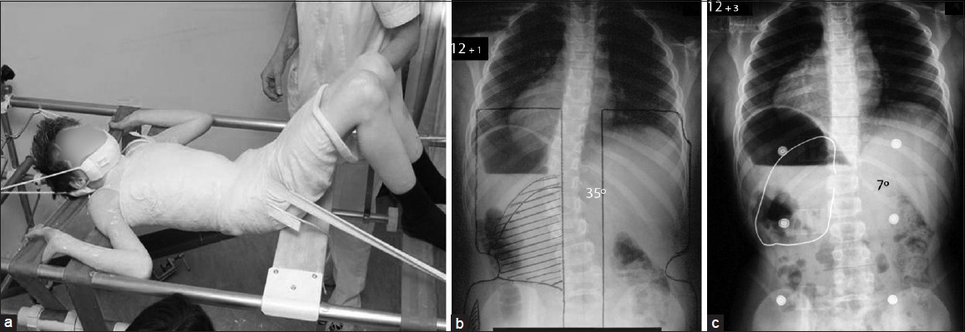
ELIZABETHTOWN CRIPPLED CHILDREN’S HOSPITAL
SCOLIOSIS
  MANIPULATION
  CAST
  DOCTOR VISIT MONTHLY
  HOSPITAL STAY
    15 MOS.

Slide 12
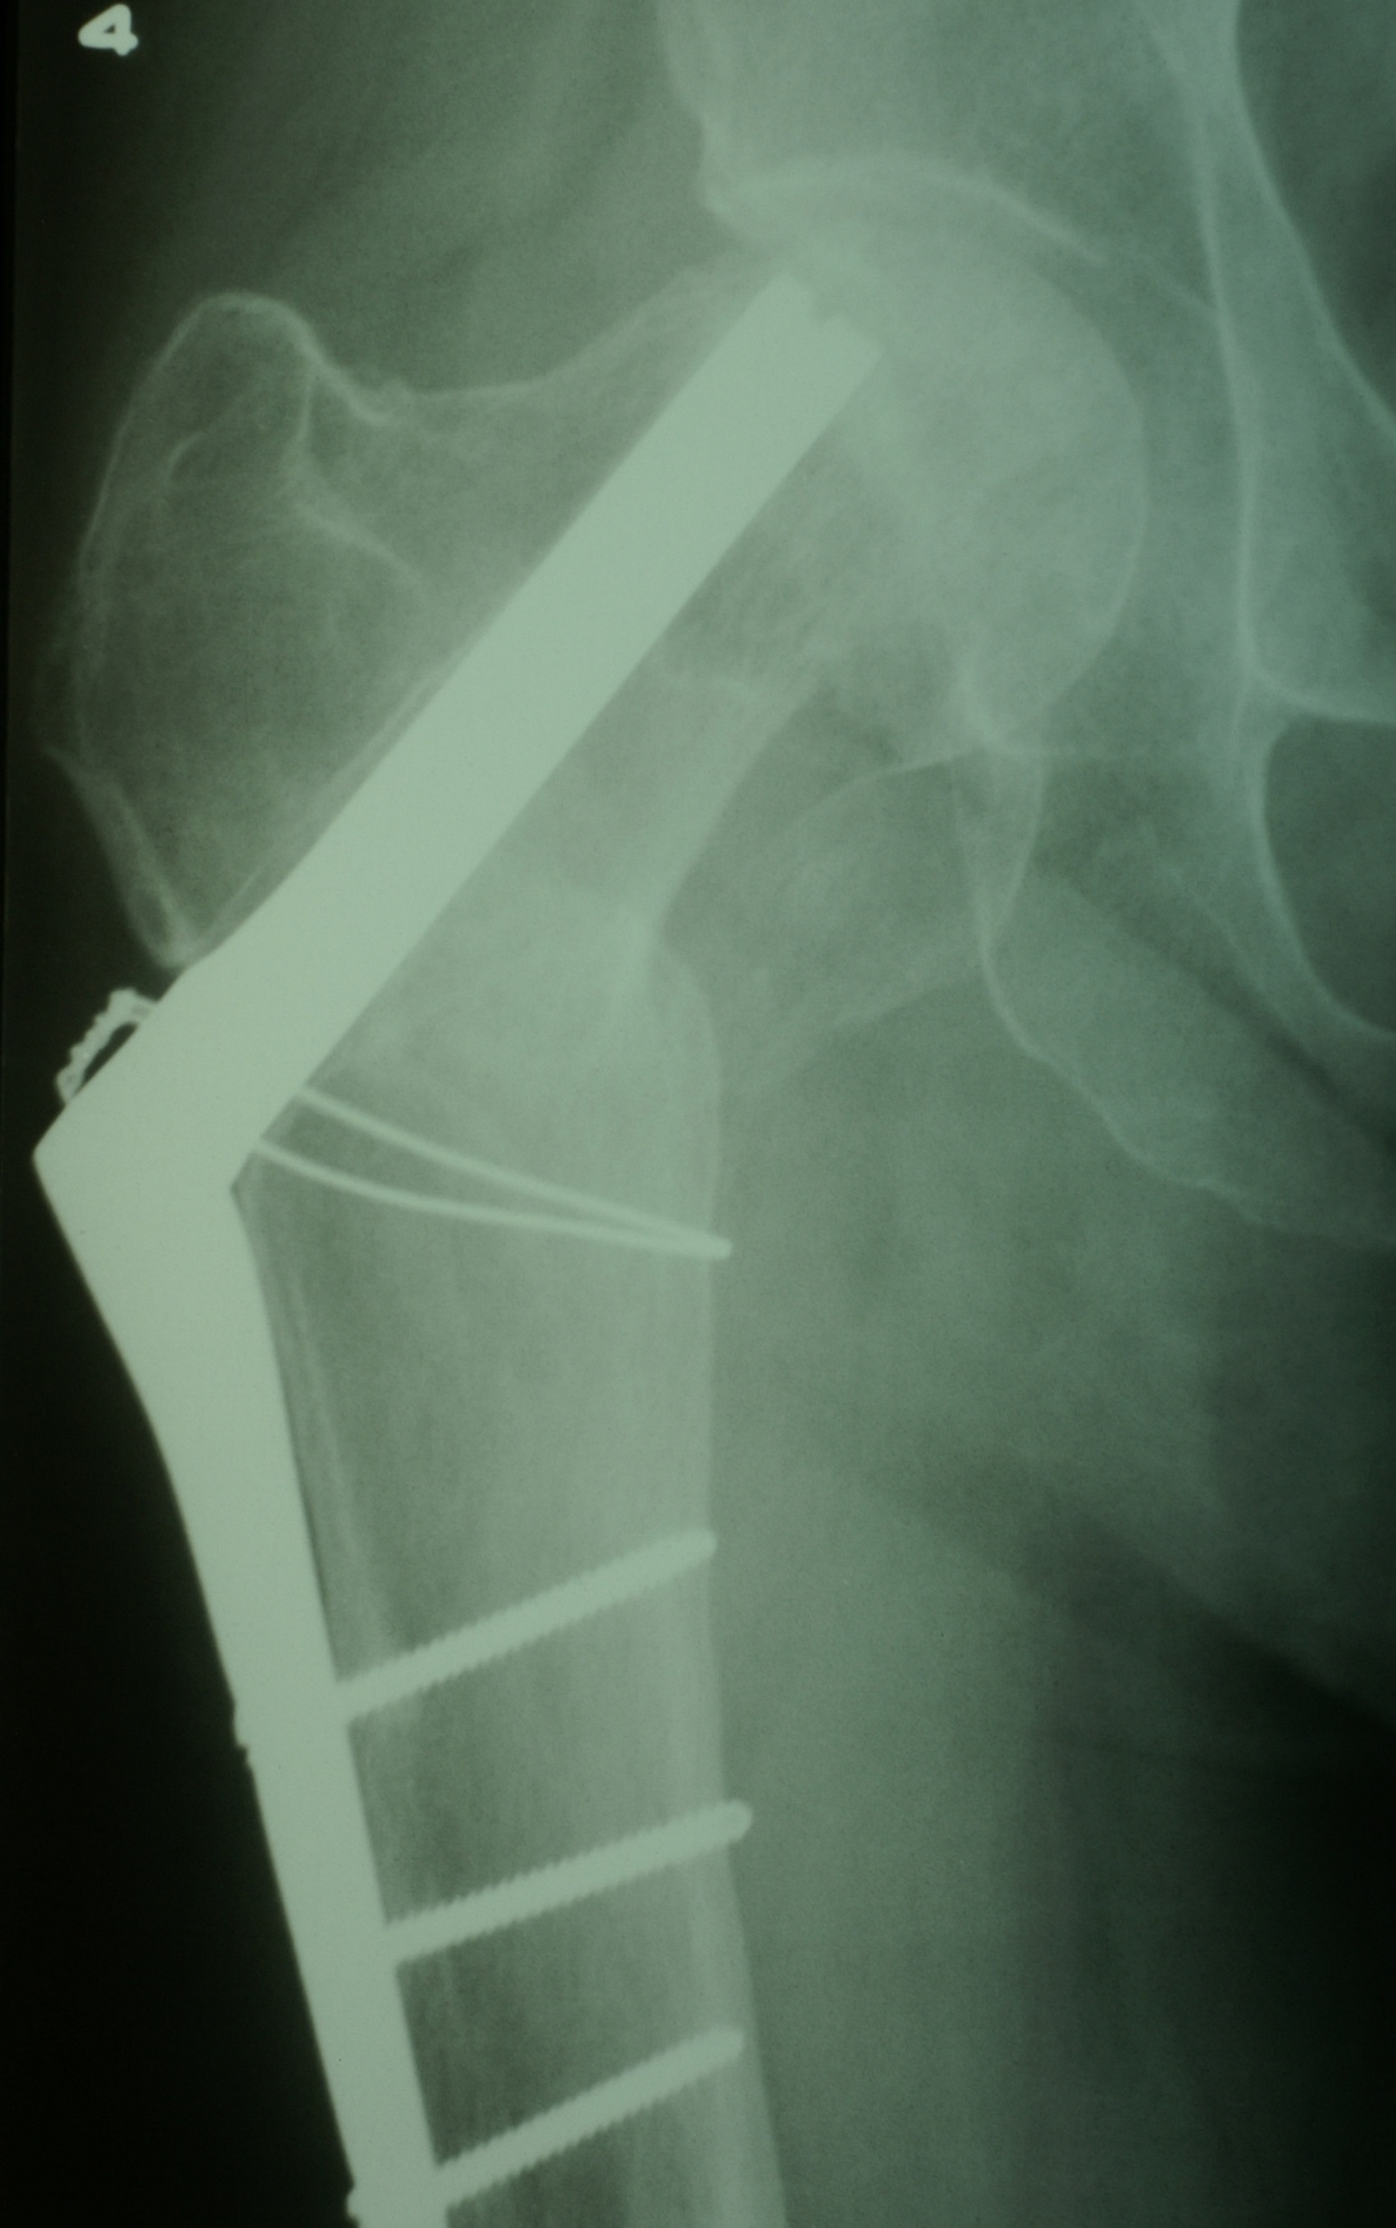
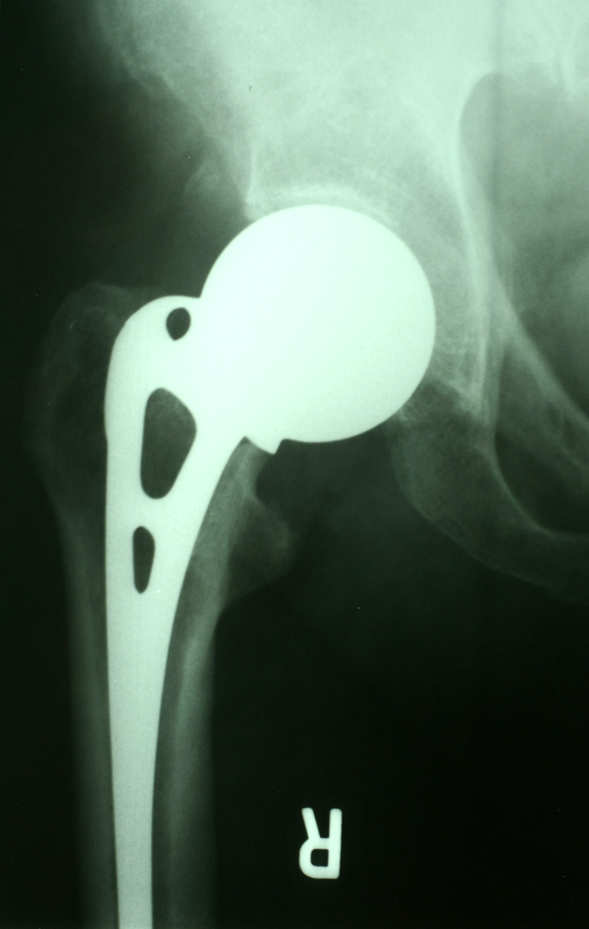
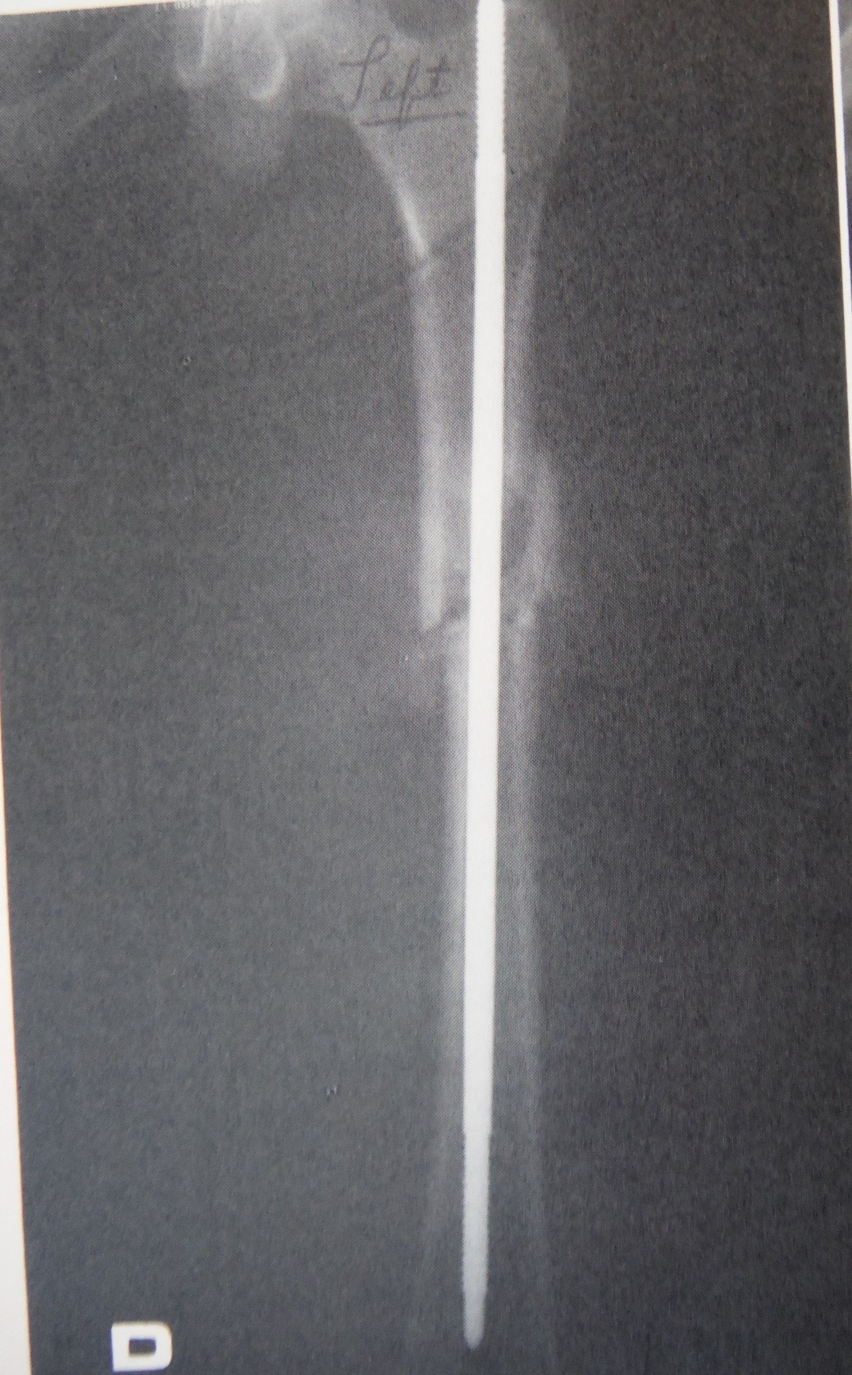
PRE-1970 LANCASTER COUNTY ORTHOPEDICS - TRAUMA

Slide 13
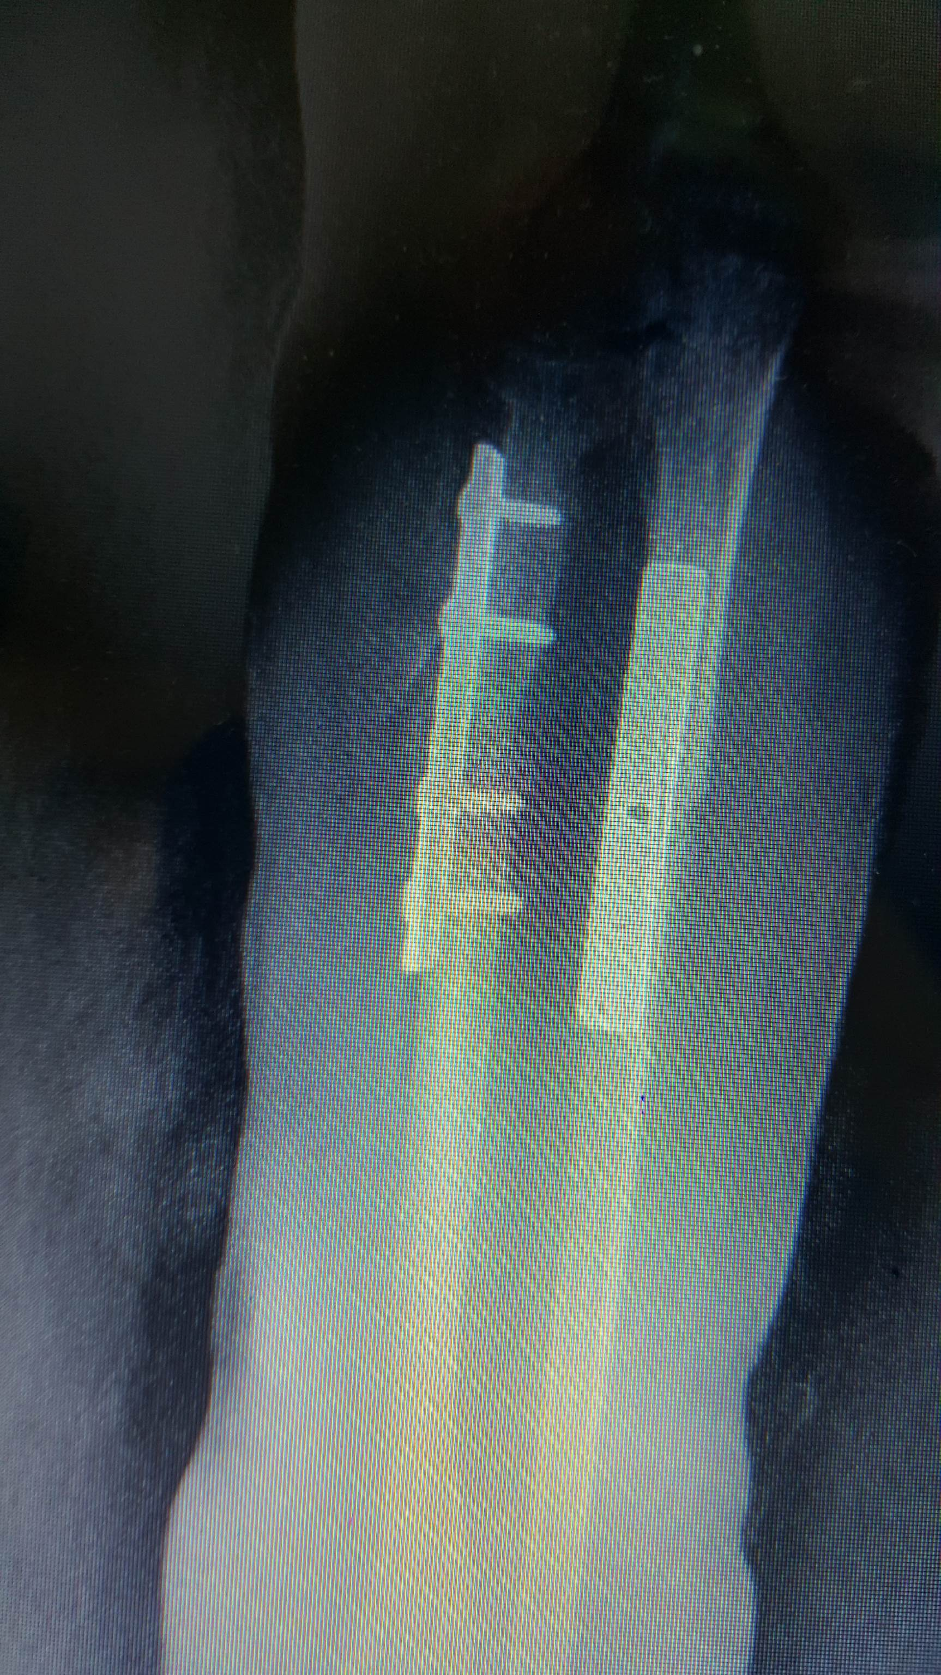
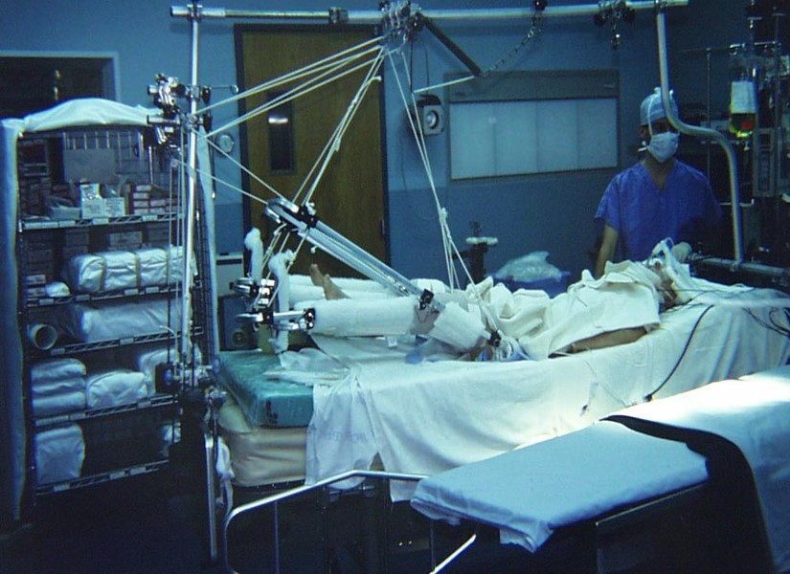
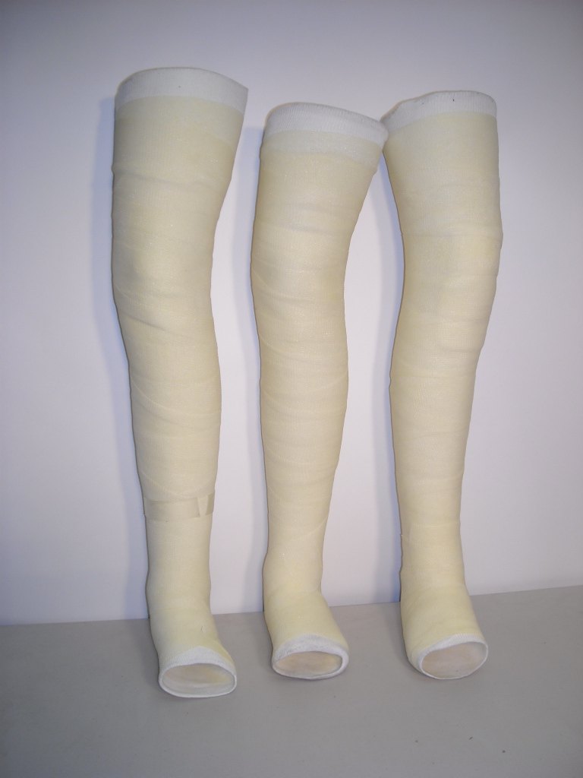
PRE-1970 LANCASTER COUNTY ORTHOPEDICS - TRAUMA

Slide 14
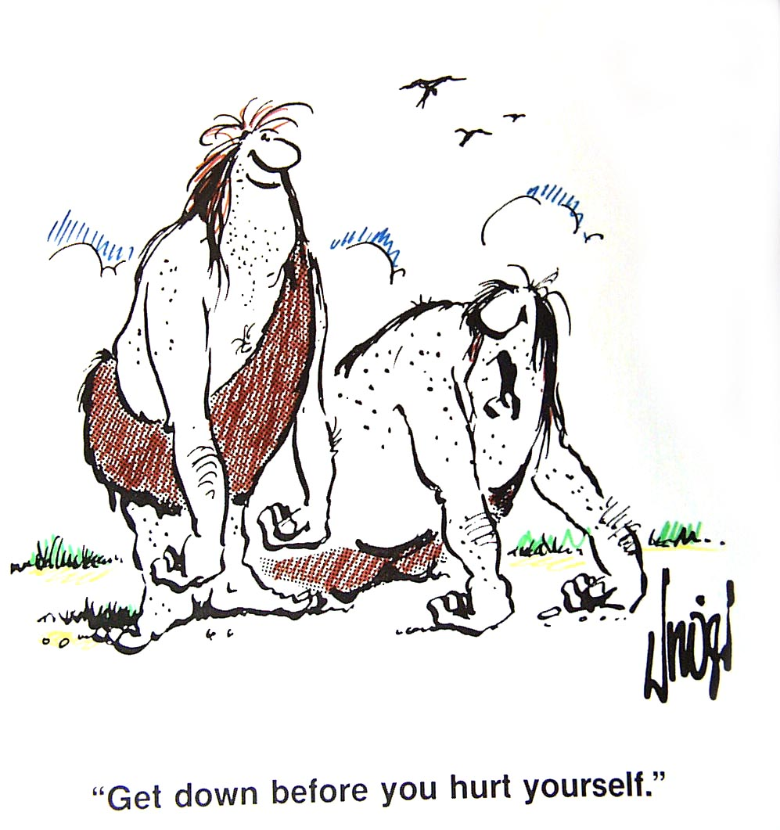
PRE-1970 LANCASTER COUNTY ORTHOPEDICS - SPINE
DISC SURGERY
  1930s
BACK FUSION

Slide 15
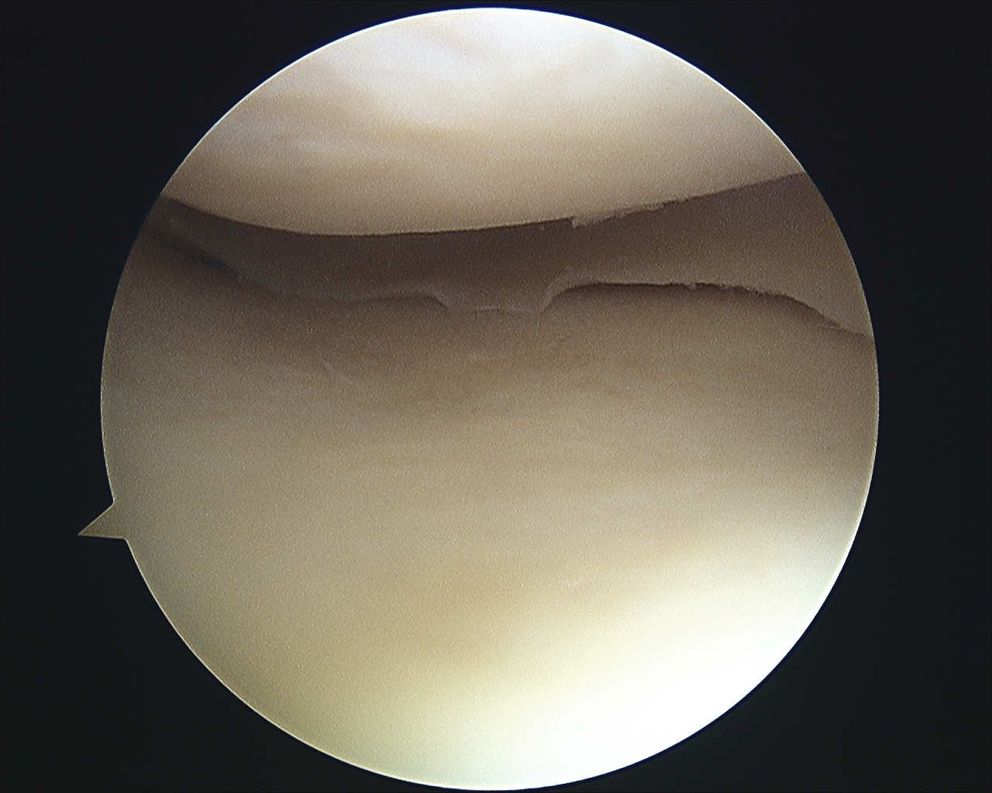
PRE-1970 LANCASTER COUNTY SPORTS – WORKER INJURY
OPEN MENISECTOMY
  WEEK IN HOSPITAL
  CAST
LIGAMENT INJURY
  STAPLE
  CAST
ROTATOR CUFF TEAR
  SURGERY

Slide 16
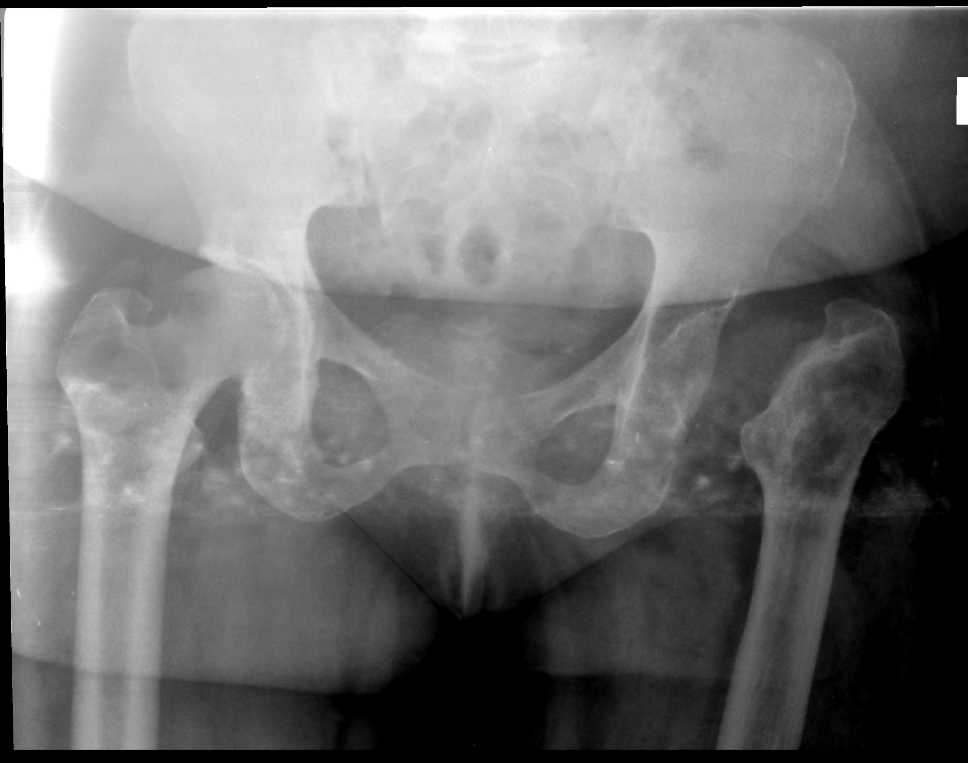
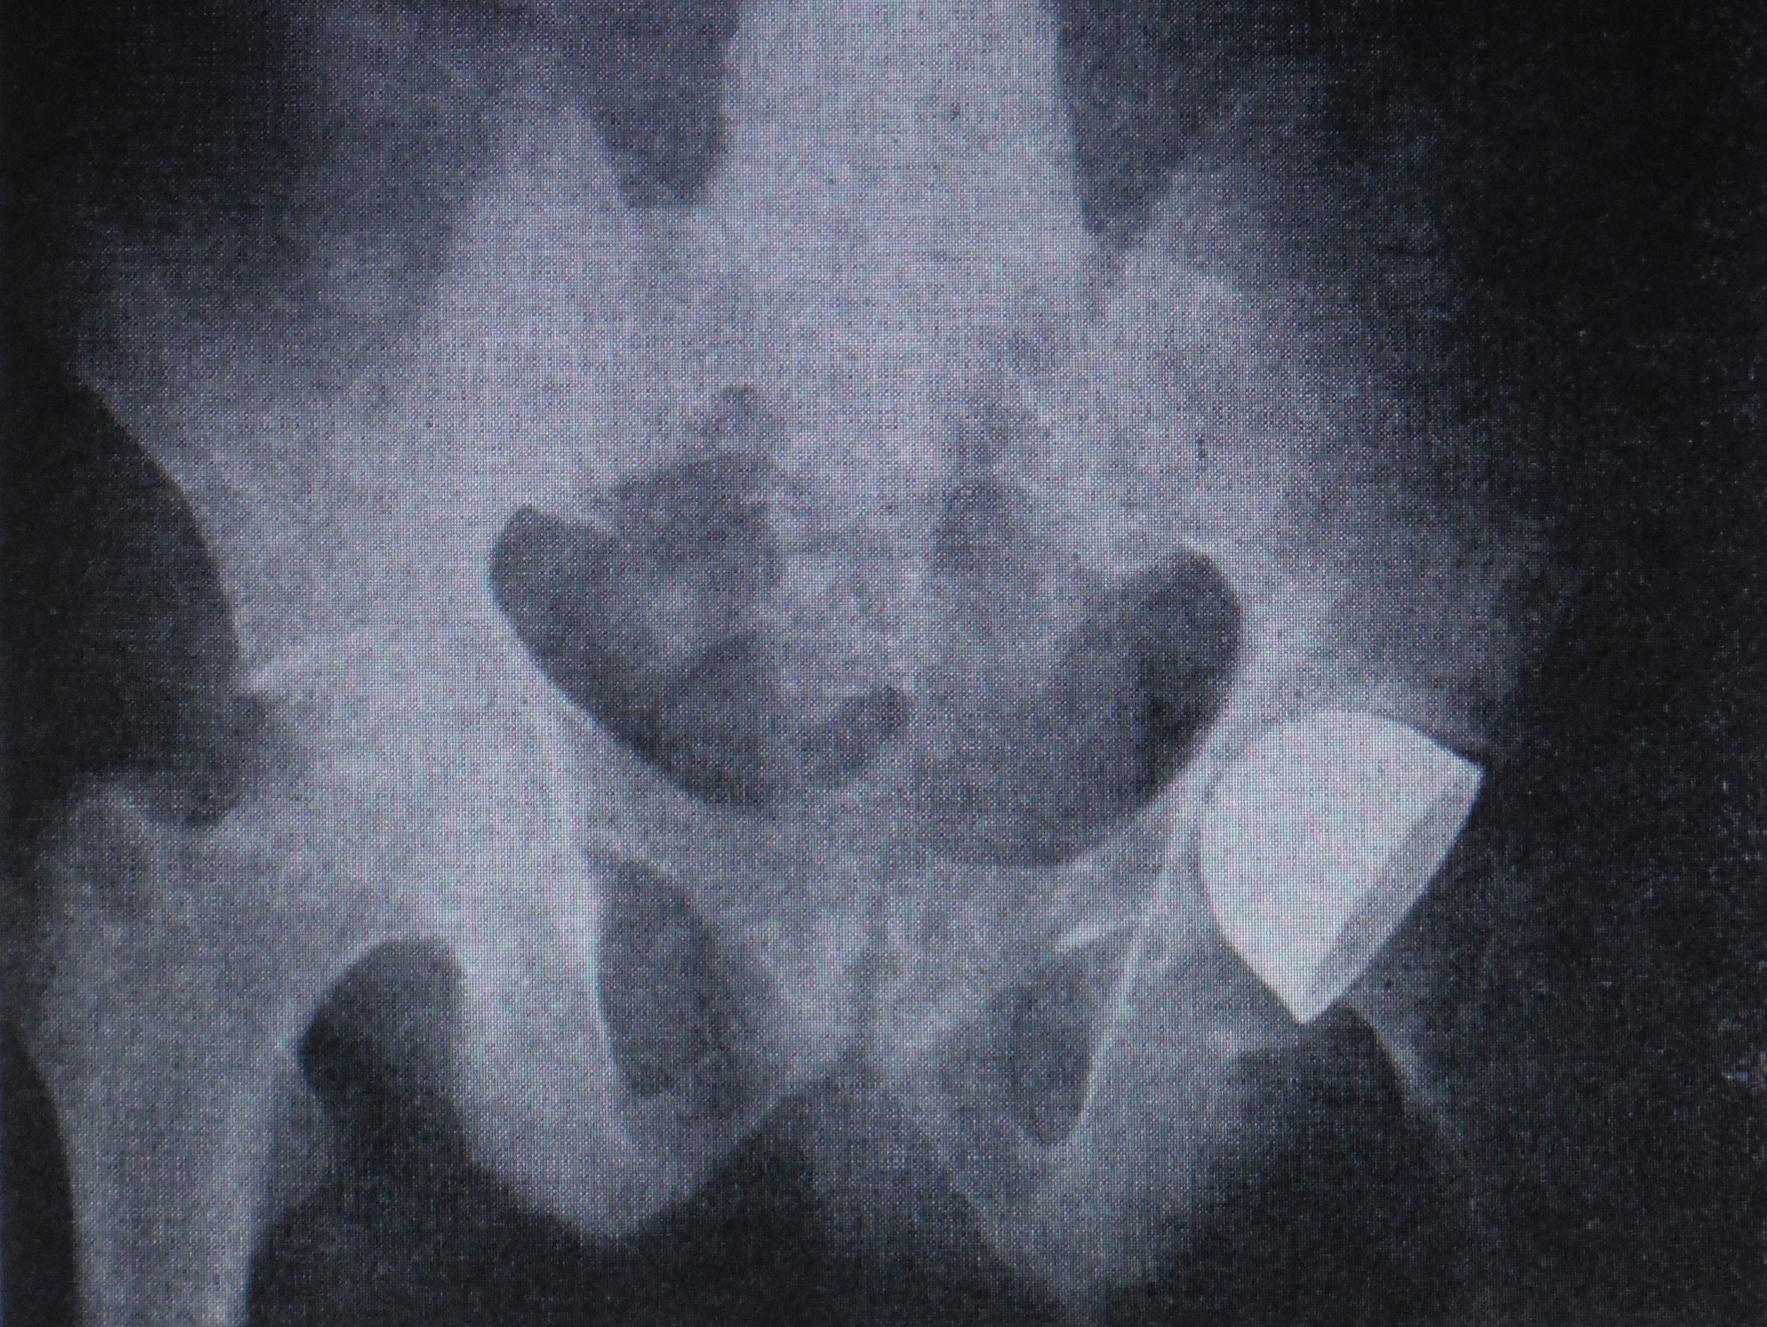
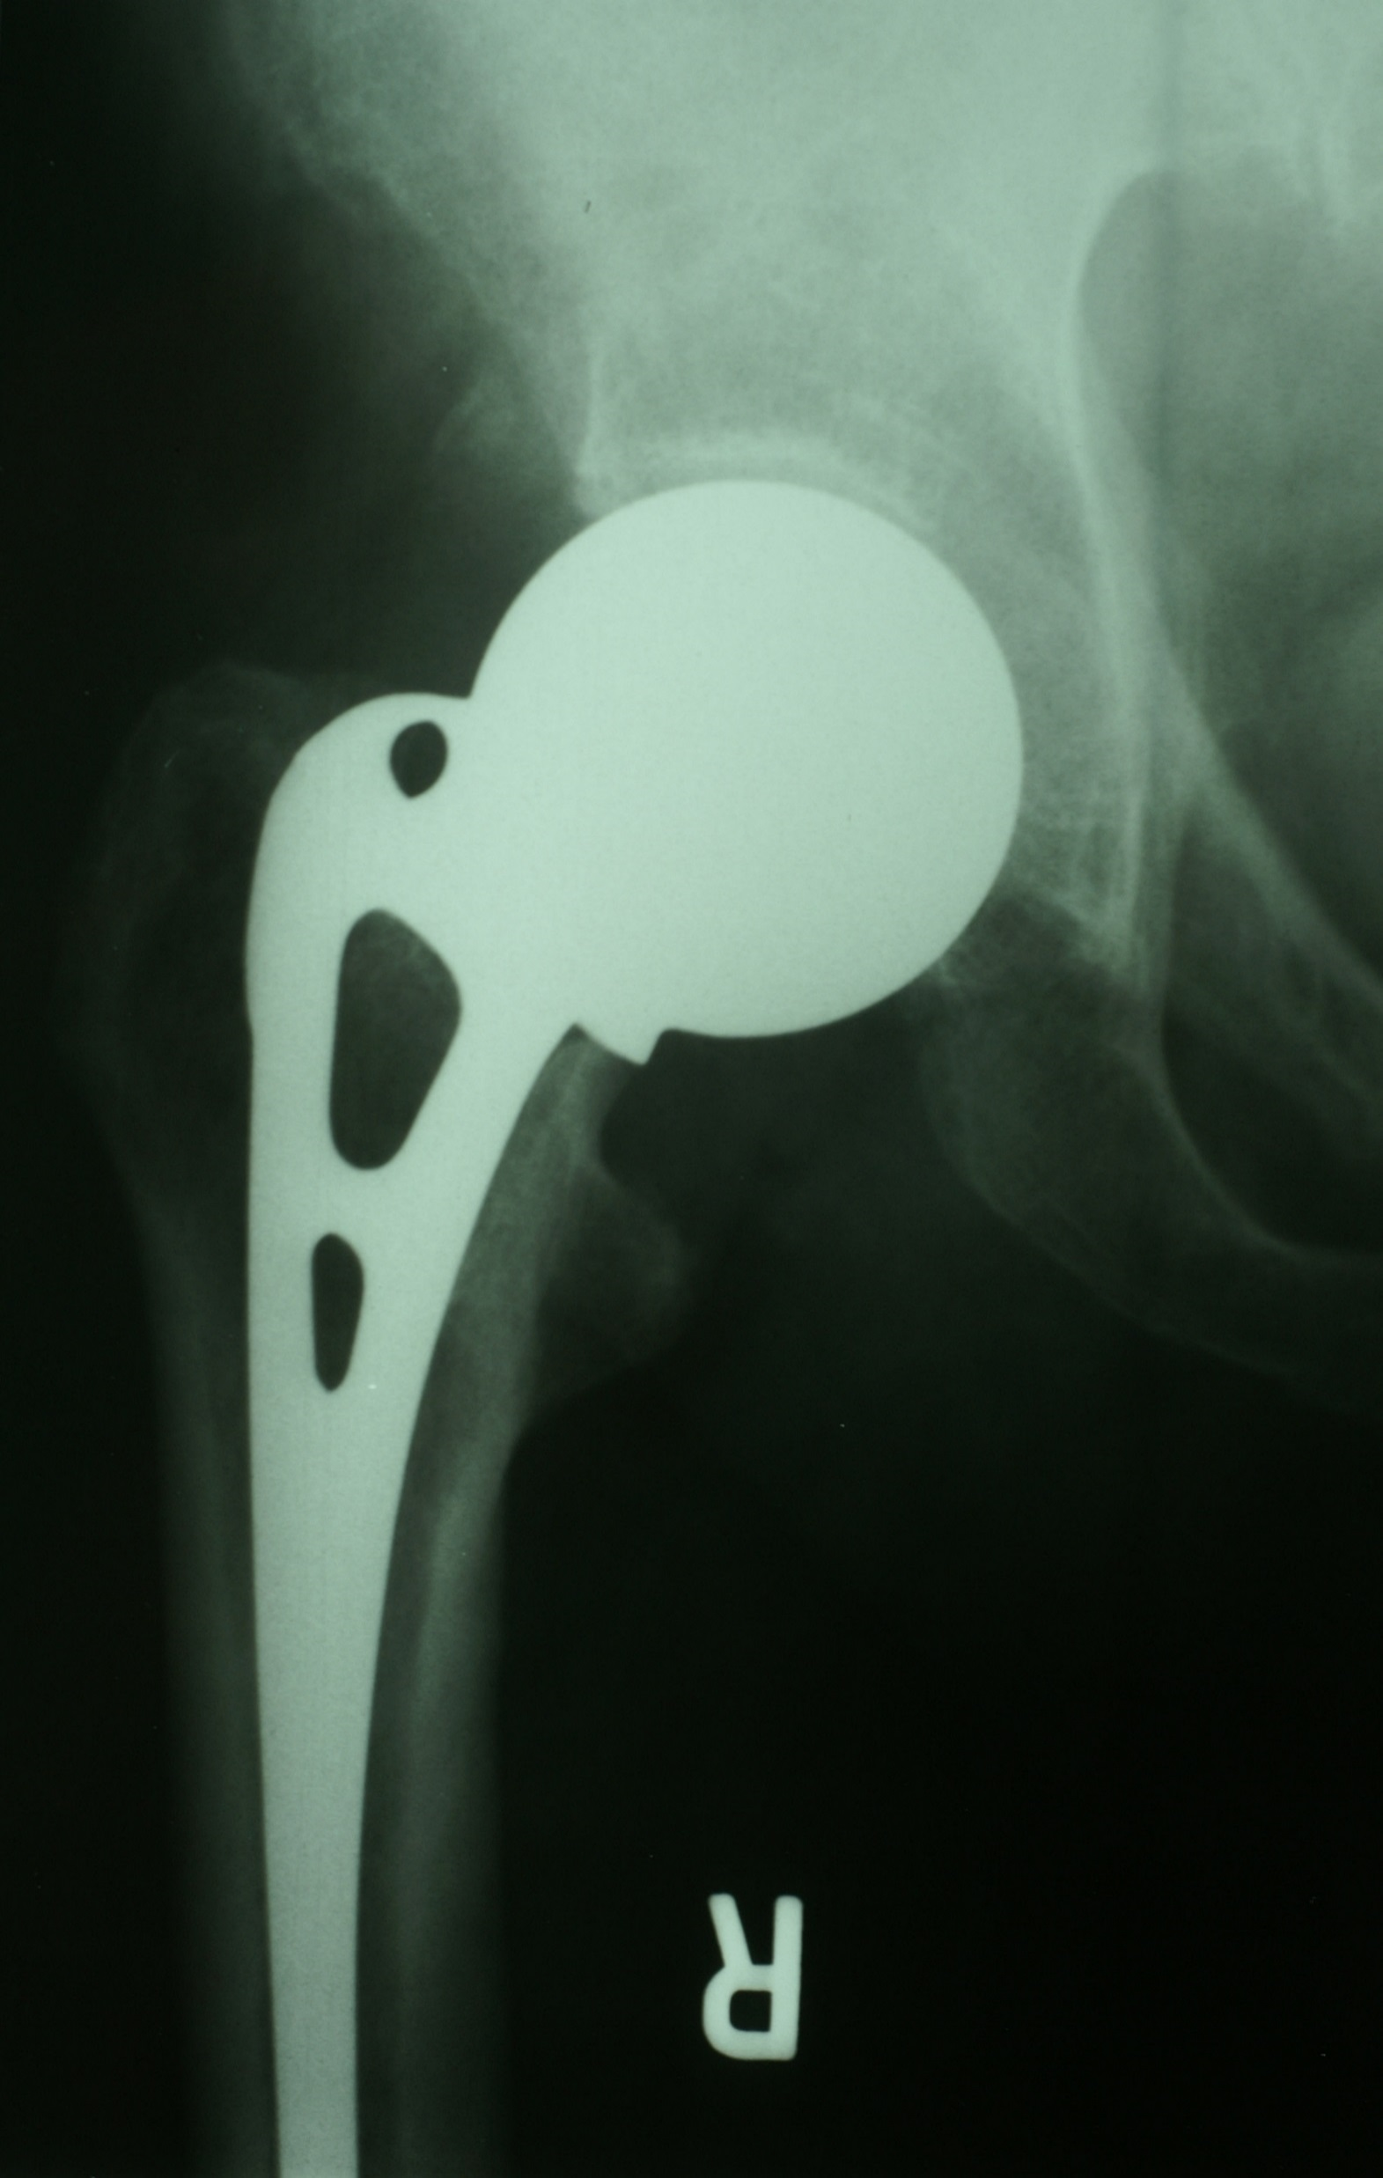
PRE-1970 LANCASTER COUNTY ORTHOPEDICS - ARTHRITIS
CUP
ARTHRO-
PLASTY
GIRDLESTONE
AUSTIN-MOORE
PROSTHESIS

Slide 17
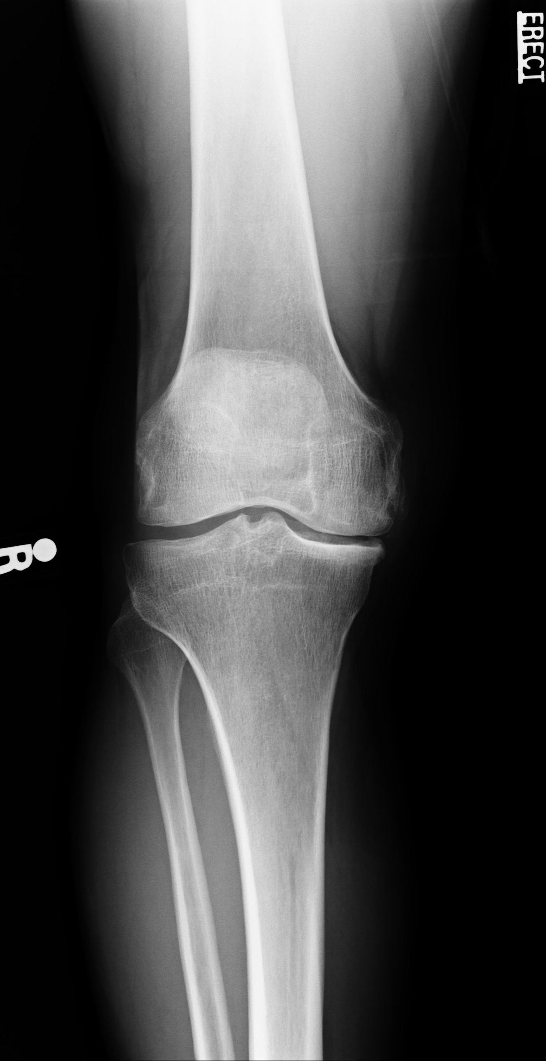
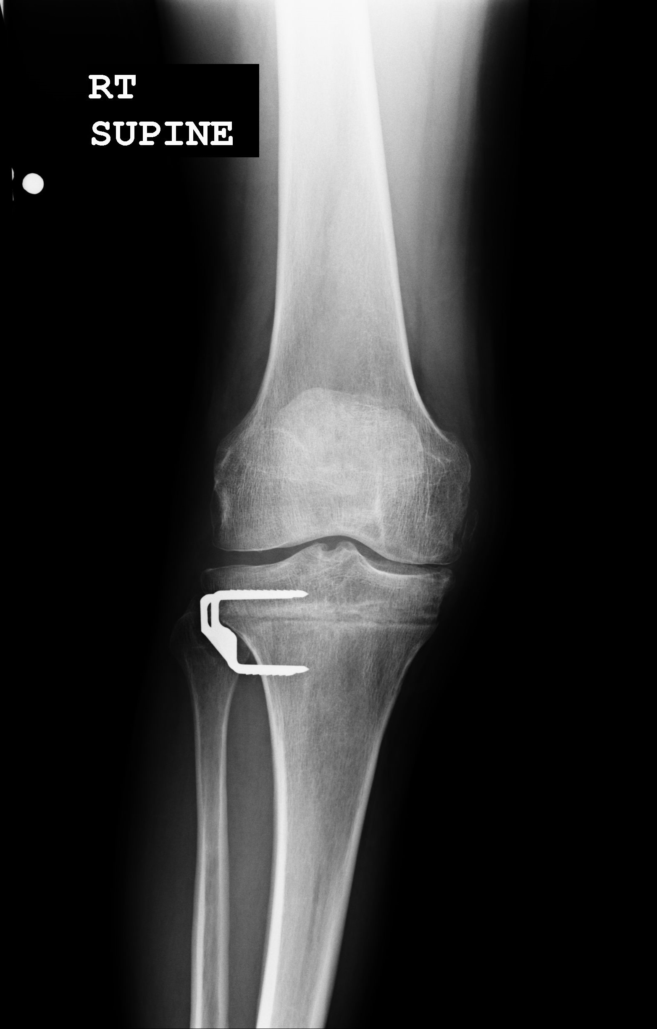

PRE-1970 LANCASTER COUNTY ORTHOPEDICS - ARTHRITIS
OSTEOTOMY

Slide 18
1960s LANCASTER COUNTY ORTHOPEDICS
POLIO
  VACCINE
SCOLIOSIS
  SCHOOL SCREENING
SPINE
TRAUMA
SPORTS

Slide 19
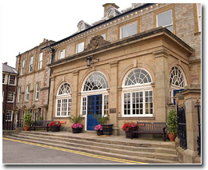
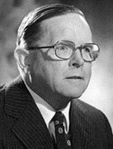
TOTAL HIP REPLACEMENT
1960s
CRITERIA
  DURABLE
    LOW FRICTION
  STRONG
  BIO-COMPATABLE
SIR JOHN CHARNLEY
WRIGHTINGTON HOSPITAL
LANCASHIRE, ENGLAND

Slide 20
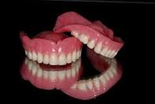
FIXATION
POLYMETHYLMETHACRYLATE (PMMA)
  DENTURES
  LENS
  BONE CEMENT!

Slide 21
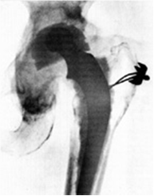
BEARING SURFACES
1958 TEFLON AND METAL- ONLY LASTED 1 YEAR

Slide 22
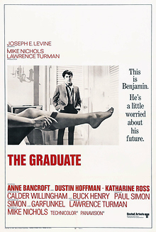
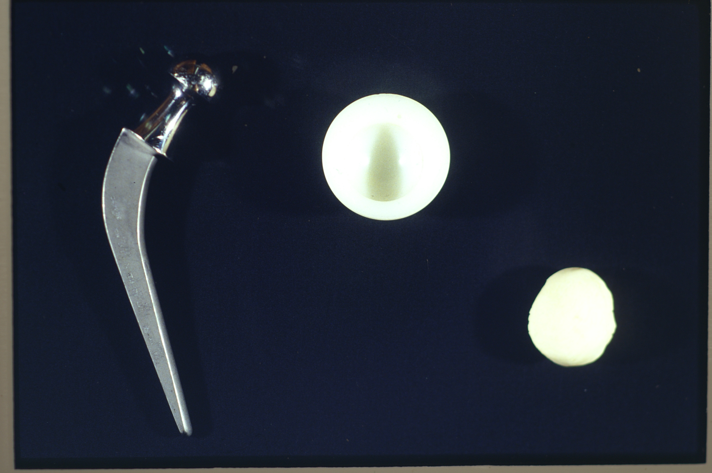
TOTAL HIP REPLACEMENT
1960s
STAINLESS STEEL BALL PLASTIC CUP – POLYETHYLENE ACRYLIC CEMENT -PMMA
“One Word, Plastic”

Slide 23
TOTAL HIP REPLACEMENT
LANCASTER COUNTY
CHRIS C. COOKE, M.D.

Slide 24
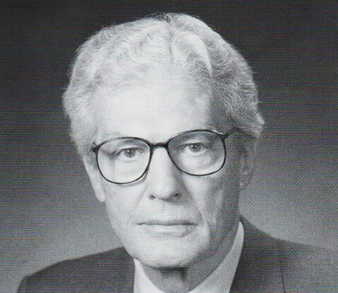
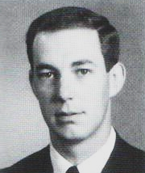
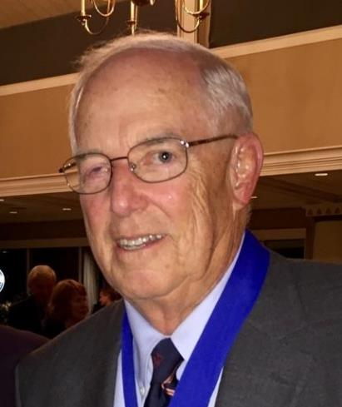
TOTAL HIP REPLACEMENT
1969
DR. MARK COVENTRY
MAYO CLINIC
FIRST FDA APPROVAL TO USE BONE CEMENT
DR. JOHN
SHERTZER
MAYO CLINIC
CO-FOUNDER OAL

Slide 25
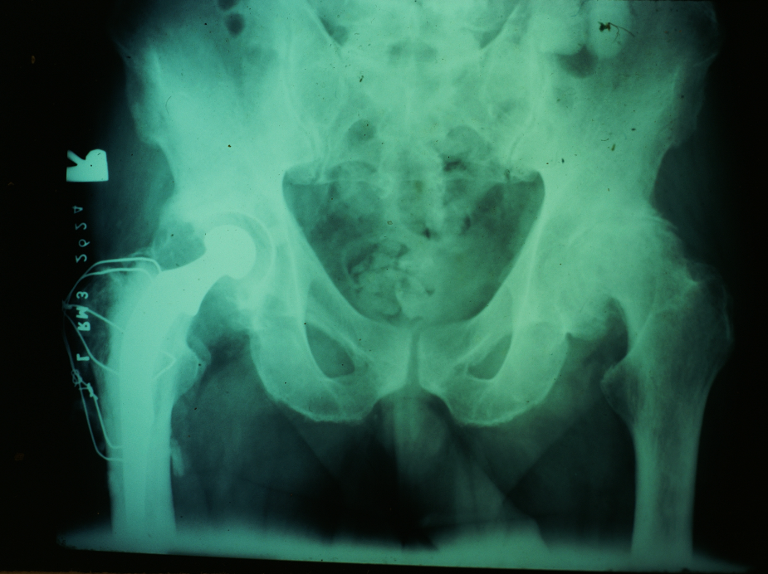
TOTAL HIP REPLACEMENT
LANCASTER COUNTY
“PLASTIC” CUP,
CEMENTED
STAINLESS STEEL BALL
AND STEM,
TROCHANTER REMOVED
AND REPAIRED

Slide 26
TOTAL HIPS IN LANCASTER
JANUARY, 1972 FDA APPROVES BONE CEMENT
DR. JOHN SHERTZER – MR. YOUNG – KNOWN ENTIRE LIFE
CHARNLEY MULLER
1972-1985
GREAT LONGEVITY!

Slide 27
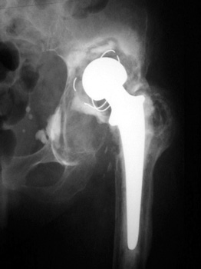
LOOSENING (CEMENT DISEASE)
NEED BETTER FIXATION
GET RID OF CEMENT
BONE INGROWTH
PRESS FIT PCA
  Porous Coated Anatomic

Slide 28
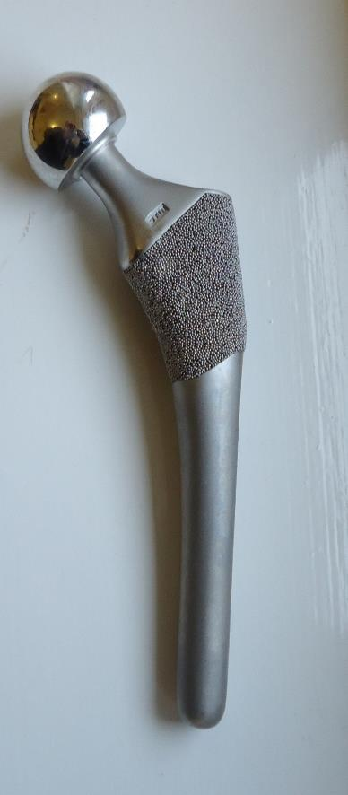
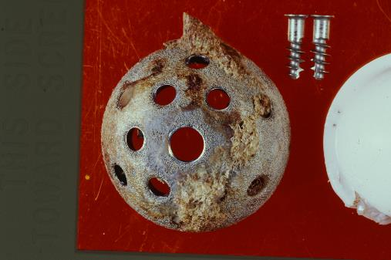
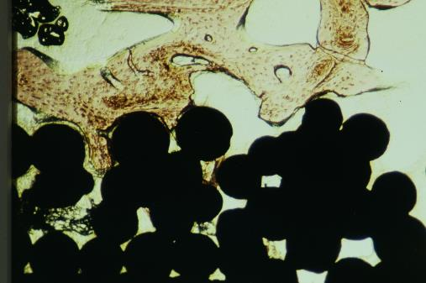
1980’s
PCA with Modular Head
Cemented Stems Preferred
Alumina Ceramics
Press fit Modular Cups
  Original ones cemented
  because of skepticism

Slide 29
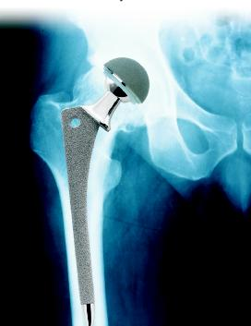
1990’s
AML HIPS START
EARLY 1990’S PRESS FIT CUPS FOUND TO BE SUPERIOR- INDUSTRY STANDARD
ALUMINA HEADS
  CERAMIC
  HIGH FRACTURE RATE
  ZIRCONIA HEADS HIT THE MARKET- POOR WEAR

Slide 30
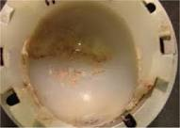
1990’s
POLYETHYLENE WEAR NOW GREATEST THREAT TO LONGEVITY -NEED BETTER POLY
HYLAMER, 1990 – BAD IDEA
HIGHLY CROSSLINKED POLYETHYLENE – MARKETED 1998

Slide 31
POLYETHYLENE IMPROVEMENT
VOLUMETRIC WEAR RATE
TRADITIONAL POLY
HIGHLY CROSS
LINKED POLY

Slide 32
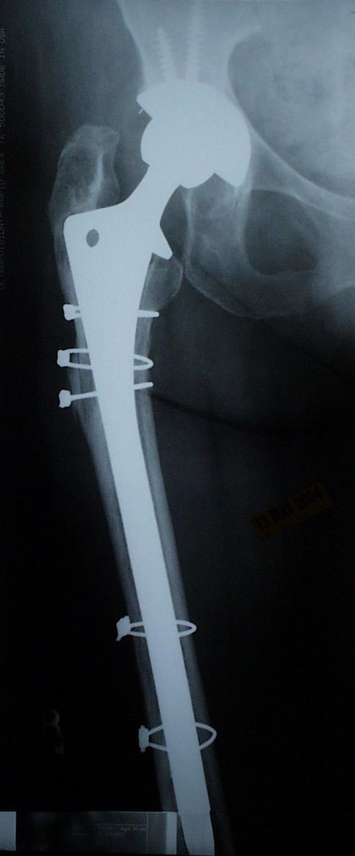
REVISION
TOTAL JOINT REPLACEMENT
DEPENDENT ON
  AGE
  ACTIVITY
  WEIGHT
  LUCK
    MECHANICAL ALIGNMENT

Slide 33
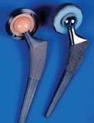
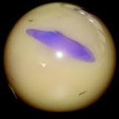
NEW MILLENIUM
DIRECT VENDOR TO PATIENT MARKETING
2003 FDA APPROVES CERAMIC ON CERAMIC DESIGNS – SQUEAKERS (2005)
BIOLOX CERAMIC, 2003

Slide 34

2000-2010
BIRMINGHAM HIP AND METAL ON METAL FRENZY – BAD IDEA
HIGHLY CROSSLINKED POLYETHYLENE BECOMES INDUSTRY STANDARD

Slide 35
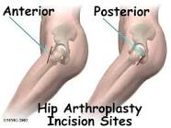
MINIMALLY INVASIVE SURGERY
2002 – 2 INCISION TECHNIQUE, DR. CARL ADOLPH
C. 2004 – MINI POSTERIOR (BACK) AFTER SOME TRYING MINI ANTERIOR (FRONT)

Slide 36
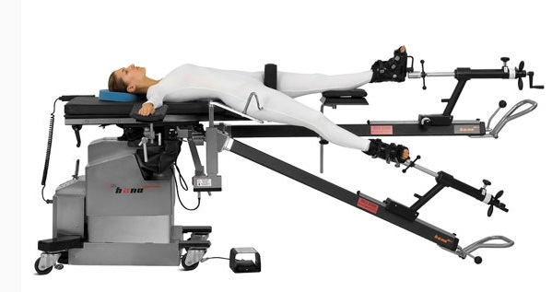
MIS
JULY 12, 2011 DR SETH BAUBLITZ DOES FIRST ROBOTIC THA AT LANCASTER REGIONAL MEDICAL CENTER
2012, DR ESSIS DOES FIRST DIRECT ANTERIOR THA AT LGH ON HANNA TABLE.

Slide 37
2010’s
RECESSION OF 2008 AND ACA DROP INCENTIVE FOR NEW DESIGNS
BUNDLED PAYMENT PROGRAMS INCENTIVIZE LOWER COST ITEMS
BACK TO METAL ON PLASTIC
MIS OF EITHER APPROACH USED BY MOST SURGEONS

Slide 38

TOTAL HIP REPLACEMENT
USA
PRIMARY THR – 310,000!
REVISION THR – 40,000!

